Slide 1

忄
纟
彳
+
CHERISH THE FLOWERS,LOOKING BACK AS BEFORE.
惜
落
花
随
风
回首往昔
2028
扌

Slide 2

忄
扌
DIRECTORY
01
第壹节
目 录
纟
02
第贰节
03
第叁节
04
第肆节
05
第伍节

Slide 3


酝酿着心碎的声音，行无数高山涉水，走又一世沧桑成道。何时不喜欢这种满心追逐的？无数次，当心累了，站在空旷的天空下，寻找还能栖息的感觉，可不知；那颗怦动的心，就像在风雨中淋湿过似得。
THE BREATH OF AUGUST, BREWING THE HEARTBREAKING VOICE, WADING THROUGH COUNTLESS MOUNTAINS AND SORROWS. WHEN DO YOU NOT LIKE THIS KIND OF CHASE? COUNTLESS TIMES, WHEN YOU ARE TIRED, STANDING UNDER THE OPEN SKY, LOOKING FOR THE FEELING OF BEING ABLE TO PERCH, BUT I DON’T KNOW; THE SWAYING HEART IS LIKE GETTING WET IN THE WIND AND RAIN.

Slide 4


悲伤灌溉了心事的行囊，无数次穿越在寻找的旅途里，随着漂泊的心，带上还未起飞的梦儿，追逐在风景里的驿站。有一个地方，我无数次路过，可怎么也靠不近；有一个人，我用尽所有的爱，可怎么也爱不到，原来；人生莫过于失去和珍惜。
SADNESS IRRIGATED THE SACS OF THE MIND, AND CROSSED THE SEARCH FOR THE COUNTLESS TIMES, WITH THE DRIFTING HEART, CARRYING THE DREAM THAT HAD NOT YET TAKEN OFF, CHASING THE STATION IN THE LANDSCAPE. THERE IS A PLACE WHERE I HAVE PASSED BY COUNTLESS TIMES, BUT I CAN'T RELY ON IT. THERE IS ONE PERSON, I USE ALL MY LOVE, BUT I CAN'T LOVE IT. IT TURNS OUT THAT LIFE IS NOTHING MORE THAN LOSS AND CHERISH.

Slide 5


是是非非的凡尘，梦一般碎落，风一样无痕。携手规划了下一站的旅途，终不知，坎坷早已逼近在前行的脚步，我用尽所有的气力，怎么也挣脱不了上帝安排好的路。
亦或许；当跌倒之后，才知道失败的味道，当时光溜走以后，才回忆起往昔的美好。
OR MAYBE; AFTER FALLING, I ONLY KNOW THE TASTE OF FAILURE. AT THAT TIME, AFTER THE LIGHT SLIPPED AWAY, I REMEMBERED THE GOODNESS OF THE PAST.

Slide 6





惜落花随风，
回首如昔。
走过了，错过了。抓住了，失去了。人生，反反复复地上演着一席又一席的画面。当我再一次重新认识自己时，我才知道，原来；我什么都不是。努力也有一种过程，而付出不定就要有结果。
GOT OVER AND MISSED IT. CAUGHT AND LOST. LIFE, REPEATED AND REPEATED PERFORMANCES OF ONE AFTER ANOTHER. WHEN I ONCE AGAIN KNEW MYSELF, I REALIZED THAT IT WAS; I AM NOTHING. THERE IS ALSO A PROCESS OF HARD WORK, AND THERE IS A RESULT IF THERE IS UNCERTAINTY.

Slide 7



夜深了，喜欢一个人静静地思考，对于孤独和寂寞，好像早已经注定是习惯。装满心事的行囊里，往事随波逐流，如风卷来。曾多少次，无声地告诉自己，做着真实的自己，人生；没有回首和追忆，只有向着前行的路，迈步前行。充满渴望和憧憬，或许；梦想里的下一站，不一定很远。
LATE AT NIGHT, I LIKE TO THINK QUIETLY. FOR LONELINESS AND LONELINESS, IT SEEMS TO BE A HABIT. IN THE BAG FILLED WITH THOUGHTS, THE PAST FLOWS WITH THE TIDE, SUCH AS THE WIND. HOW MANY TIMES HAVE YOU TOLD YOURSELF SILENTLY THAT YOU ARE DOING YOUR TRUE SELF AND LIFE; WITHOUT LOOKING BACK AND REMINISCING, YOU CAN ONLY MOVE FORWARD ON THE ROAD AHEAD. FULL OF EAGERNESS AND EMBARRASSMENT, PERHAPS; THE NEXT STOP IN THE DREAM IS NOT NECESSARILY FAR AWAY.

Slide 8

很多时候，对着文字敲在纸笺上的一行行，总是认真的读好几遍。像及了一个在静静聆听我诉说的友者，只听不语。而我就这样，对话着心情的释怀。
MANY TIMES, THE LINES OF WORDS ON THE PAPER ARE ALWAYS READ CAREFULLY SEVERAL TIMES. LIKE A FRIEND WHO IS QUIETLY LISTENING TO WHAT I TOLD, I JUST CAN'T SPEAK. AND I AM LIKE THIS, TALKING ABOUT THE RELEASE OF MY MOOD.
涟漪波动的心间，总能听见静水流淌的声音，于年华，与走过。
回首春秋一梦，何处道尽满凄凉？

Slide 9


THERE IS ALWAYS A SENTENCE; "SOME PEOPLE, ONCE LOVED IT," IN THE FACE OF COUNTLESS HAPPY PICTURES, THE SIRE OF THE NEXT LOVE, AND AFTER ALL, MISSED. A PERFECT LOVE, THE PROTAGONIST OF CREATION, WILL ALWAYS BE EACH OTHER. THE CONCEPT OF HAPPINESS IS TO ESTABLISH, THE IDEA OF MANAGEMENT IS TO PAY, WHEN ONE DAY, THE ORIGINAL THINGS IN LIFE DISAPPEAR INSTANTLY, FACING THE ATTITUDE OF ACCEPTANCE, ONLY TO DISCOVER; A BUSTLING END OF THE ROAD, FROM THEN ON.
总有那么一句话；"有些人，曾爱过就好"面对无数幸福的画面，狠下的说下爱过了，终究是错过了。一段完美的爱情，营造的主角，永远是彼此。幸福的概念就是去建立，经营的理念就是付出，当有一天，生命里原本的东西，瞬间消失，面对着接受的姿态，才发现；一场末路繁华，从此形影孤单。

Slide 10

沉默的黑夜，闪烁着微微心的灯火，涌动的川流不息，因念而起。斑斑驳驳的烦闷，敲斜着悲伤波动的影子，深沉的寂静在空空的心房里颤动。从容一份悲伤，注定暗香随动。那些埋葬在心里的疼，无人能懂。穿梭在记忆的深处，感受光阴给的青春，在往昔的长廊里，早已老去光阴，如落花随风，逝去无痕。
THE SILENT NIGHT, FLASHING WITH A SLIGHT HEART OF LIGHT, THE SURGING STREAM IS CONSTANTLY COMING, BECAUSE OF THE THOUGHTS. THE STREAKED GROTESQUENESS, KNOCKING THE SHADOW OF SADNESS AND SWAYING, THE DEEP SILENCE TREMBLED IN THE EMPTY ATRIUM. A CALM SORROW, DESTINED TO FOLLOW THE FRAGRANCE. NO ONE CAN UNDERSTAND THE PAIN THAT IS BURIED IN MY HEART. TRAVELING IN THE DEPTHS OF MEMORY, FEELING THE YOUTH OF THE TIME, IN THE LONG CORRIDOR OF THE PAST, HAS LONG BEEN OLD, SUCH AS FALLING FLOWERS WITH THE WIND, NO TRACE OF DEATH.

Slide 11

斑斑驳驳的烦闷，敲斜着悲伤波动的影子，深沉的寂静在空空的心房里颤动。从容一份悲伤，注定暗香随动。那些埋葬在心里的疼，无人能懂。穿梭在记忆的深处，感受光阴给的青春，在往昔的长廊里，早已老去光阴，如落花随风，逝去无痕。现；一场末路繁华，从此形影孤单。
THE STREAKED GROTESQUENESS, KNOCKING THE SHADOW OF SADNESS AND SWAYING, THE DEEP SILENCE TREMBLED IN THE EMPTY ATRIUM. A CALM SORROW, DESTINED TO FOLLOW THE FRAGRANCE. NO ONE CAN UNDERSTAND THE PAIN THAT IS BURIED IN MY HEART. TRAVELING IN THE DEPTHS OF MEMORY, FEELING THE YOUTH OF THE TIME, IN THE LONG CORRIDOR OF THE PAST, HAS LONG BEEN OLD, SUCH AS FALLING FLOWERS WITH THE WIND, NO TRACE OF DEATH. NOW; A BUSTLING END OF THE ROAD, FROM THEN ON.

Slide 12



IN TIME, WE MAY HAVE BEEN A STORY, SOMEONE, CLIMBING MOUNTAINS AND WADING, NOT AFRAID OF DANGER, EVEN IF THE FRONT OF THE CAPE, WILL BE CHASING A HAPPY LIFE. SUDDENLY, I FOUND THAT ALL THIS PERSISTENT ATTACHMENT IS SO UNWORTHY, SO; UNDERSTAND, FACE THE FEELING OF PAIN, ALWAYS WANT TO SAY TO MYSELF "HAVE BEEN LEARNING TO LOVE OTHERS, DO NOT KNOW, FORGET TO HURT YOURSELF."
时光里；我们都或许曾为一段故事，某个人、爬山涉水，不畏艰险，就算前面的海角天涯，都会奋不顾身的去追逐一段幸福。当突然之间发现，这一切坚持的执着，就是那么的不值得时，于是；懂了，面对疼的感觉，总想对自己说"一直学着爱别人，殊不知，忘记了疼自己一下。

Slide 13
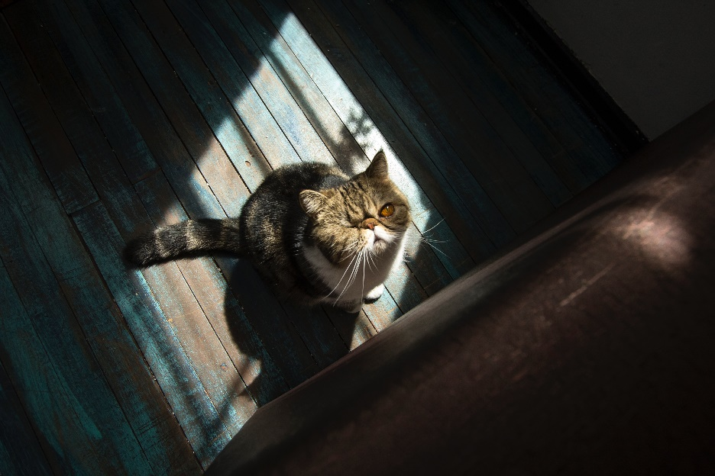


THE PEOPLE WHO ARE CHASING DREAMS ARE LIKE THIS. THEY ALWAYS WANT TO RIDE IN THE DISTANCE IN THE FUTURE AND FACE THE DRIFT OF THE HEART. IT IS IMPOSSIBLE TO GRASP THE RHYTHM OF RIGHT AND WRONG WITH THE POWER OF SELF-CONTROL. THE ROAD TO LIFE, AFTER THE TRUTH, ONLY FOUND THAT THE MOMENT OF INNOCENCE.
追梦的人都这样，总想驰骋在未来的远方，面对心的漂泊。无法用自控的力量把握对与错的节奏。人生的路途，到过真实之后，才发现，那一刻的天真。

Slide 14


若岁月静好，时光如初，那些珍藏的泪儿，会不会笑着说没事？若落幕的繁华，在平淡中有精彩，那会不会不用回首一段往昔？
IF THE YEARS ARE QUIET, THE TIME IS LIKE THE BEGINNING, THE TEARS OF THOSE TREASURES, WILL YOU LAUGH AND SAY NOTHING? IF THE END OF THE BUSTLING, THERE IS A WONDERFUL IN THE PLAIN, THEN WILL NOT HAVE TO GO BACK TO THE PAST?

Slide 15


带着泪儿，一路又一路。每一段生活的扭曲注定有着台词和插曲，和一段时光一起落幕，那些精彩过的回放，惜如落花随风，在平淡无味中，精明地回避，回首往昔，梦一样的如画。
WITH TEARS, ALL THE WAY. THE TWISTS AND TURNS OF EACH LIFE ARE BOUND TO HAVE LINES AND EPISODES, AND END WITH A PERIOD OF TIME, THOSE WONDERFUL REPLAYS, SUCH AS FALLING FLOWERS WITH THE WIND, IN THE PLAIN AND BORING, SHREWDLY SHY, LOOK BACK, THE DREAM IS AS PICTURESQUE.

Slide 16


THE BREATH OF AUGUST, BREWING THE HEARTBREAKING VOICE, WADING THROUGH COUNTLESS MOUNTAINS AND SORROWS. WHEN DO YOU NOT LIKE THIS KIND OF CHASE? COUNTLESS TIMES, WHEN YOU ARE TIRED, STANDING UNDER THE OPEN SKY, LOOKING FOR THE FEELING OF BEING ABLE TO PERCH, BUT I DON’T KNOW; THE SWAYING HEART IS LIKE GETTING WET IN THE WIND AND RAIN.
酝酿着心碎的声音，行无数高山涉水，走又一世沧桑成道。何时不喜欢这种满心追逐的？无数次，当心累了，站在空旷的天空下，寻找还能栖息的感觉，可不知；那颗怦动的心，就像在风雨中淋湿过似得。

Slide 17

悲伤灌溉了心事的行囊，无数次穿越在寻找的旅途里，随着漂泊的心，带上还未起飞的梦儿，追逐在风景里的驿站。有一个地方，我无数次路过，可怎么也靠不近；有一个人，我用尽所有的爱，可怎么也爱不到，原来；人生莫过于失去和珍惜。
SADNESS IRRIGATED THE SACS OF THE MIND, AND CROSSED THE SEARCH FOR THE COUNTLESS TIMES, WITH THE DRIFTING HEART, CARRYING THE DREAM THAT HAD NOT YET TAKEN OFF, CHASING THE STATION IN THE LANDSCAPE. THERE IS A PLACE WHERE I HAVE PASSED BY COUNTLESS TIMES, BUT I CAN'T RELY ON IT. THERE IS ONE PERSON, I USE ALL MY LOVE, BUT I CAN'T LOVE IT. IT TURNS OUT THAT LIFE IS NOTHING MORE THAN LOSS AND CHERISH.

Slide 18

是是非非的凡尘，梦一般碎落，风一样无痕。携手规划了下一站的旅途，终不知，坎坷早已逼近在前行的脚步，我用尽所有的气力，怎么也挣脱不了上帝安排好的路。
亦或许；当跌倒之后，才知道失败的味道，当时光溜走以后，才回忆起往昔的美好。
OR MAYBE; AFTER FALLING, I ONLY KNOW THE TASTE OF FAILURE. AT THAT TIME, AFTER THE LIGHT SLIPPED AWAY, I REMEMBERED THE GOODNESS OF THE PAST.

Slide 19

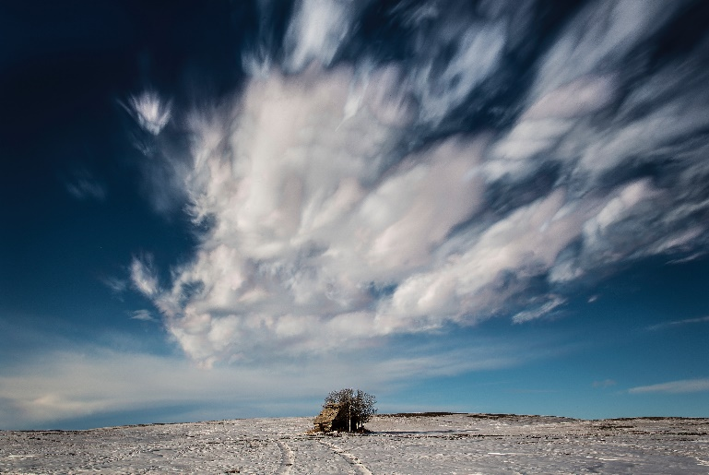
走过了，错过了。抓住了，失去了。人生，反反复复地上演着一席又一席的画面。当我再一次重新认识自己时，我才知道，原来；我什么都不是。努力也有一种过程，而付出不定就要有结果。
GOT OVER AND MISSED IT. CAUGHT AND LOST. LIFE, REPEATED AND REPEATED PERFORMANCES OF ONE AFTER ANOTHER. WHEN I ONCE AGAIN KNEW MYSELF, I REALIZED THAT IT WAS; I AM NOTHING. THERE IS ALSO A PROCESS OF HARD WORK, AND THERE IS A RESULT IF THERE IS UNCERTAINTY.

Slide 20

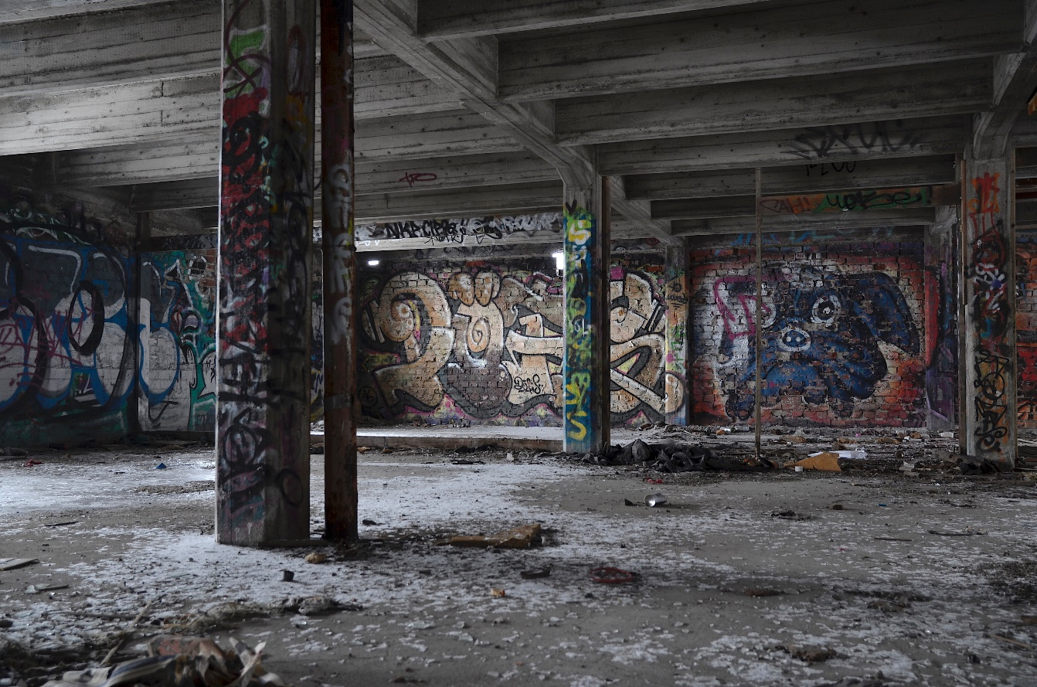
夜深了，喜欢一个人静静地思考，对于孤独和寂寞，好像早已经注定是习惯。装满心事的行囊里，往事随波逐流，如风卷来。曾多少次，无声地告诉自己，做着真实的自己，人生；没有回首和追忆，只有向着前行的路，迈步前行。充满渴望和憧憬，或许；梦想里的下一站，不一定很远。
LATE AT NIGHT, I LIKE TO THINK QUIETLY. FOR LONELINESS AND LONELINESS, IT SEEMS TO BE A HABIT. IN THE BAG FILLED WITH THOUGHTS, THE PAST FLOWS WITH THE TIDE, SUCH AS THE WIND. HOW MANY TIMES HAVE YOU TOLD YOURSELF SILENTLY THAT YOU ARE DOING YOUR TRUE SELF AND LIFE; WITHOUT LOOKING BACK AND REMINISCING, YOU CAN ONLY MOVE FORWARD ON THE ROAD AHEAD. FULL OF EAGERNESS AND EMBARRASSMENT, PERHAPS; THE NEXT STOP IN THE DREAM IS NOT NECESSARILY FAR AWAY.

Slide 21


涟漪波动的心间，总能听见静水流淌的声音，于年华，与走过。
回首春秋一梦，何处道尽满凄凉？
MANY TIMES, THE LINES OF WORDS ON THE PAPER ARE ALWAYS READ CAREFULLY SEVERAL TIMES. LIKE A FRIEND WHO IS QUIETLY LISTENING TO WHAT I TOLD, I JUST CAN'T SPEAK. AND I AM LIKE THIS, TALKING ABOUT THE RELEASE OF MY MOOD.
很多时候，对着文字敲在纸笺上的一行行，总是认真的读好几遍。像及了一个在静静聆听我诉说的友者，只听不语。而我就这样，对话着心情的释怀。

Slide 22
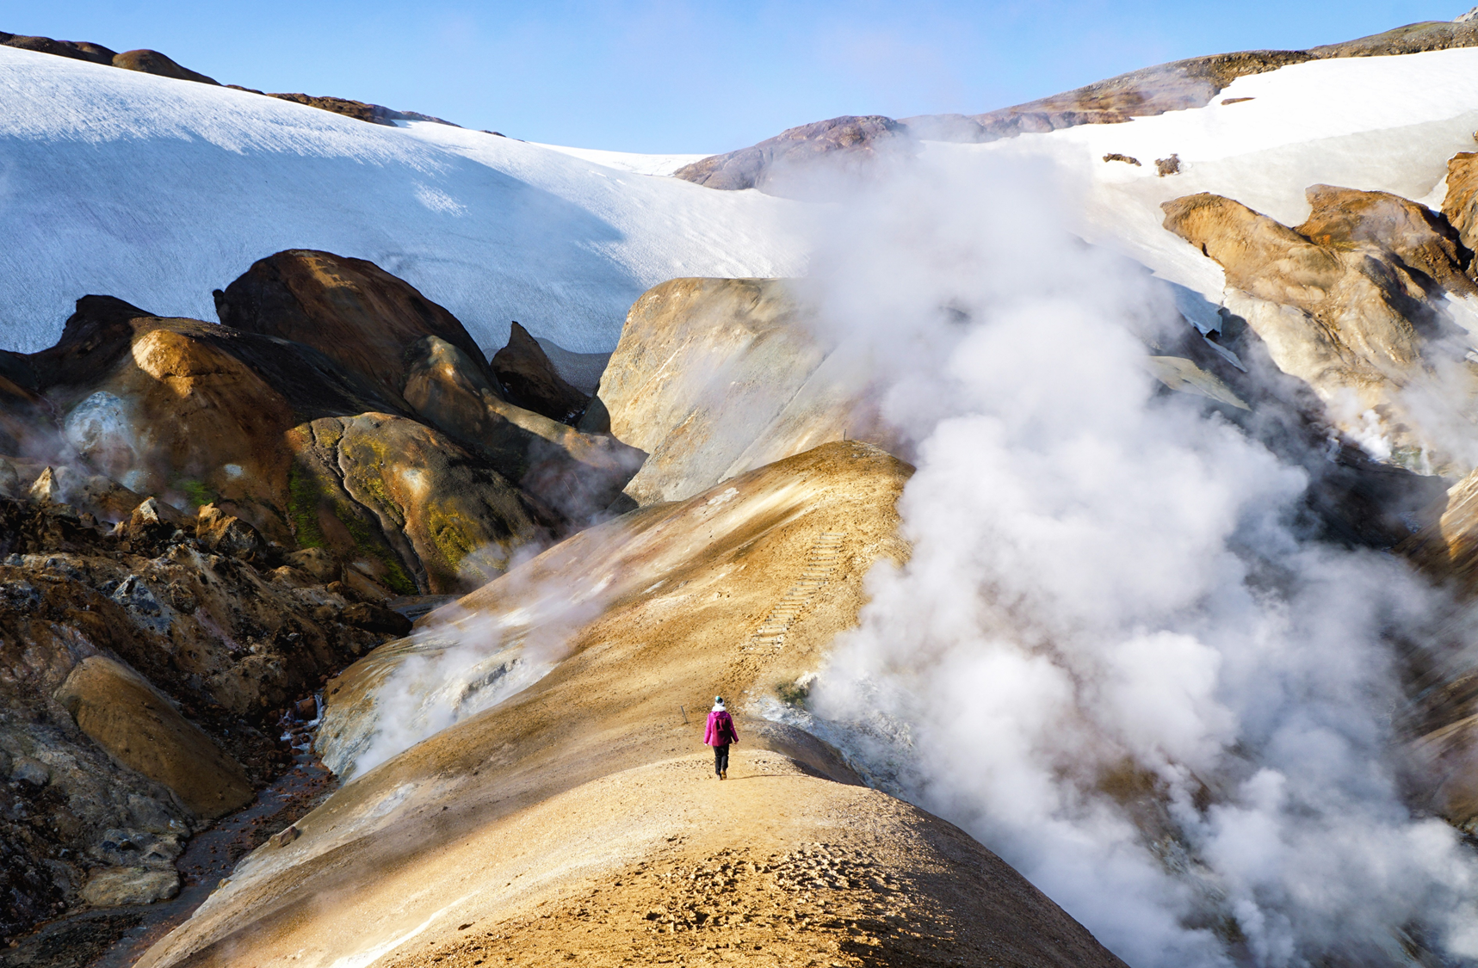
幸福的概念就是去建立，经营的理念就是付出，当有一天，生命里原本的东西，瞬间消失，面对着接受的姿态，才发现；一场末路繁华，从此形影孤单。

Slide 23

沉默的黑夜，闪烁着微微心的灯火，涌动的川流不息，因念而起。斑斑驳驳的烦闷，敲斜着悲伤波动的影子，深沉的寂静在空空的心房里颤动。从容一份悲伤，注定暗香随动。那些埋葬在心里的疼，无人能懂。穿梭在记忆的深处，感受光阴给的青春，在往昔的长廊里，早已老去光阴，如落花随风，逝去无痕。
THE SILENT NIGHT, FLASHING WITH A SLIGHT HEART OF LIGHT, THE SURGING STREAM IS CONSTANTLY COMING, BECAUSE OF THE THOUGHTS. THE STREAKED GROTESQUENESS, KNOCKING THE SHADOW OF SADNESS AND SWAYING, THE DEEP SILENCE TREMBLED IN THE EMPTY ATRIUM. A CALM SORROW, DESTINED TO FOLLOW THE FRAGRANCE. NO ONE CAN UNDERSTAND THE PAIN THAT IS BURIED IN MY HEART. TRAVELING IN THE DEPTHS OF MEMORY, FEELING THE YOUTH OF THE TIME, IN THE LONG CORRIDOR OF THE PAST, HAS LONG BEEN OLD, SUCH AS FALLING FLOWERS WITH THE WIND, NO TRACE OF DEATH.

Slide 24
忄
纟
+
彳
CHERISH THE FLOWERS,LOOKING BACK AS BEFORE.
回首往昔
THANKS YOU
2028
扌

